Slide 1
Pooling methods in Convolutional Neural Networks
(on Quick,Draw! dataset)
CSc 59929
Marina Orzechowski

Slide 2
Goals:
Why are Pooling layers important?
What are the Pooling methods?
Do overlapping or non-overlapping windows work better for my dataset?
How can I use the dataset?

Slide 3
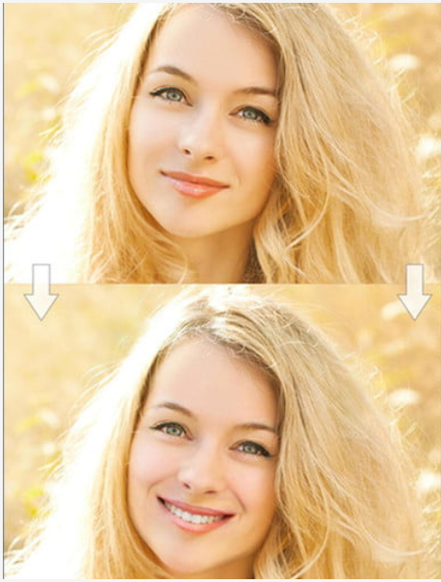
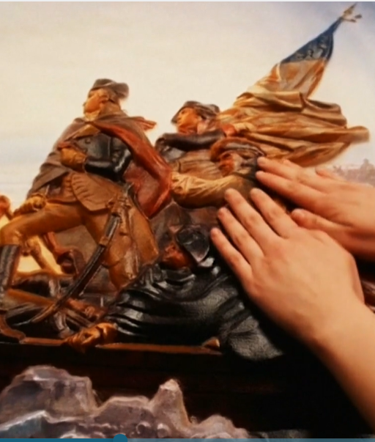
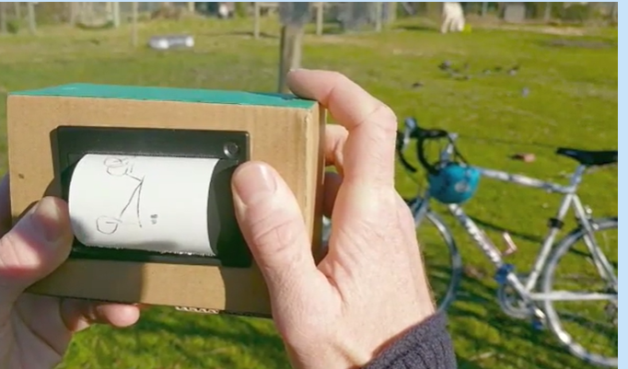
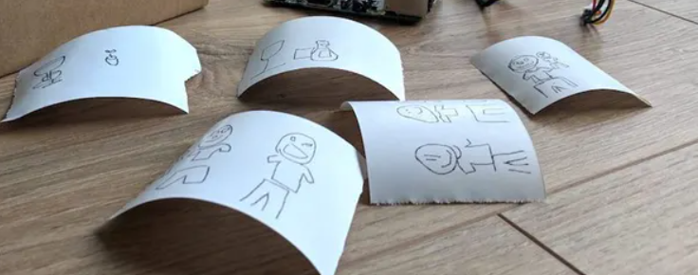
Some Applications of CNN
FaceApp:
makes you smile in a picture
Famous paintings in 3D visually impaired can experience them
Draw This App
Instant camera that draws cartoons

Slide 4
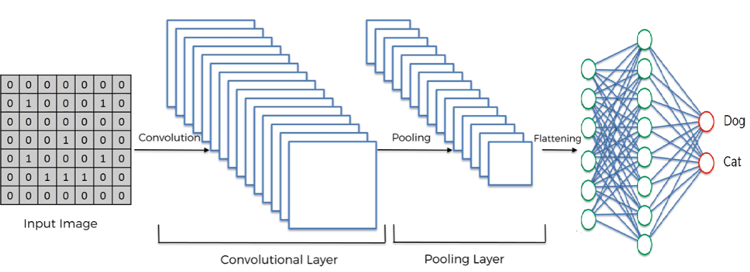
Fully connected layer

Slide 5
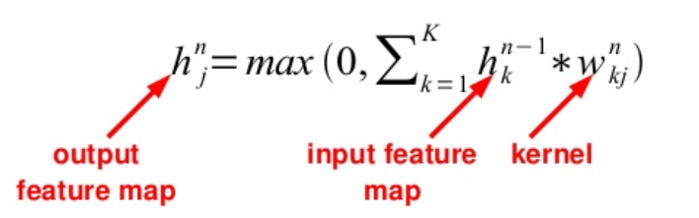
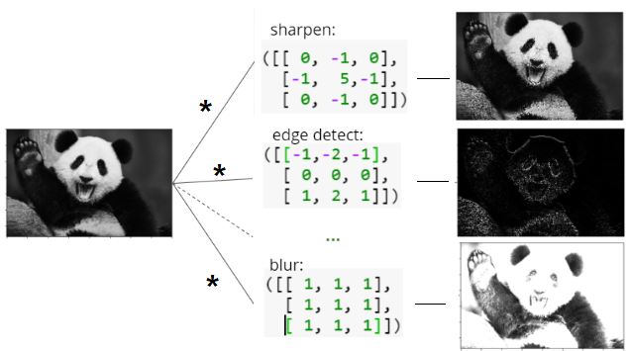
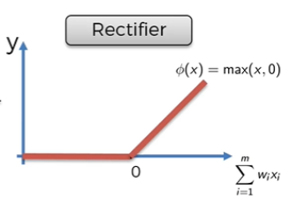
Convolutional layer
(finds features by applying different filters)
increase nonlinearity:

Slide 6
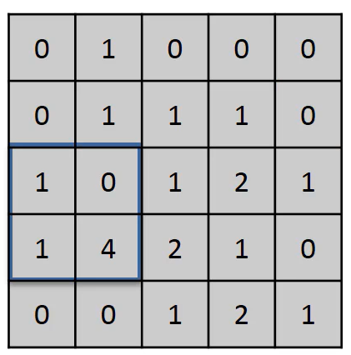

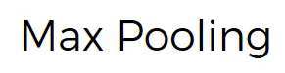
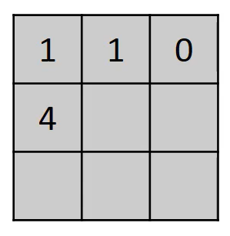
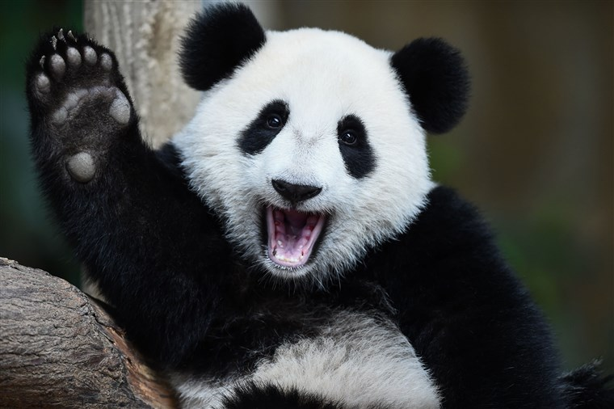
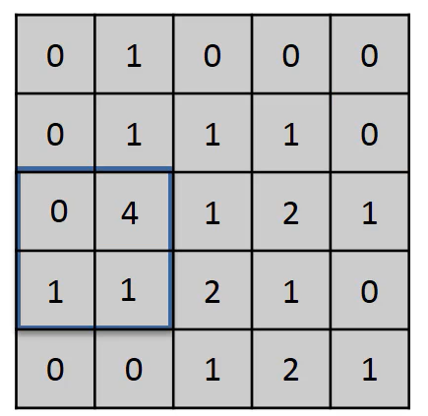
Pooling layer (down-sampling)
reduces the spatial size of the representation, retaining only most important information
reduces the number of parameters,
reduces amount of computation in the network
controls overfitting.
Model becomes approximately invariant to small translations of the input

Slide 7
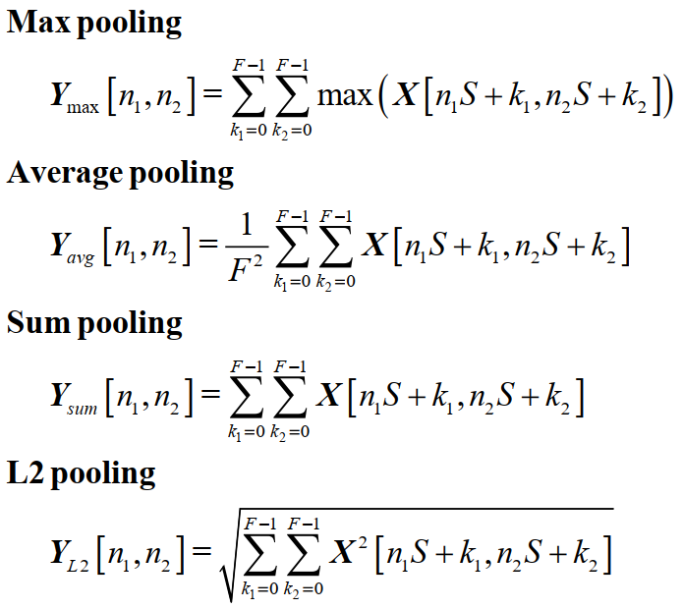
Pooling methods
“Max-pooling is the most commonly applied pooling operation. This is because it focuses on the most responsive features in question that should, in theory, make it the best candidate for image recognition and classification purposes,”
- John Hearty, Advanced ML with Python

Slide 8
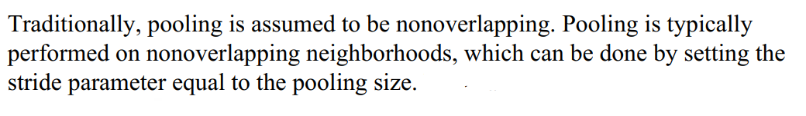
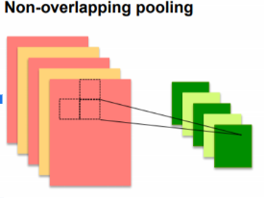
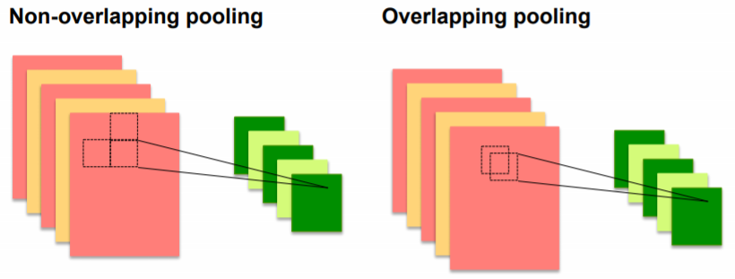
Overlapping vs non-overlapping pooling windows
(Wikipedia)
(According to our textbook)
(Geoffrey Hinton)
LeNet-5
VGGNet
AlexNet
GoogLeNet

Slide 9
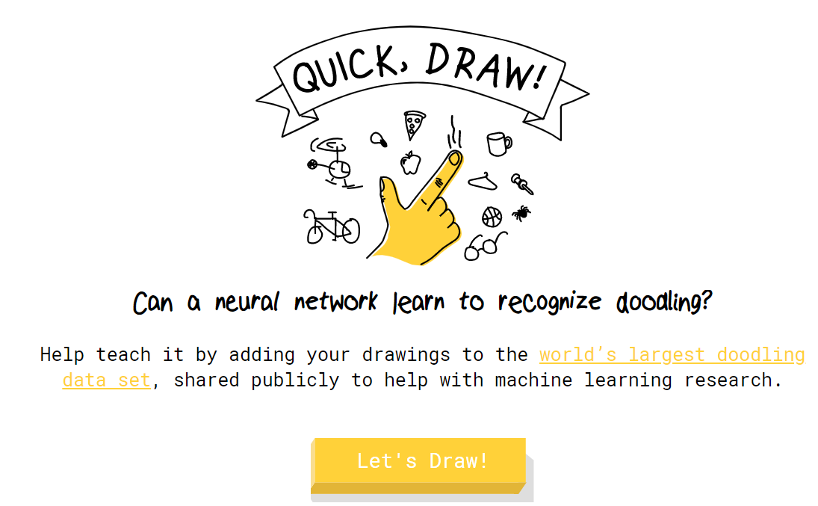
What will work better for the Quick, Draw! dataset?
The Quick Draw Dataset is a collection of 50 million drawings across 345 categories, contributed by players of the game Quick, Draw!.

Slide 10
Preprocessed data
All the drawings have been simplified and rendered into a 28x28 grayscale bitmap aligned to the center, in numpy .npy format.
What I have done:
Chose only 5 categories
Reduced dataset to 30000 for each category instead of >120000

Slide 11
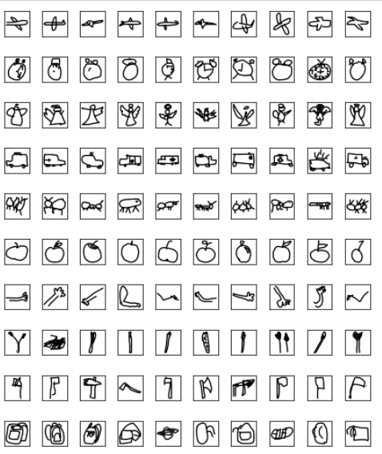
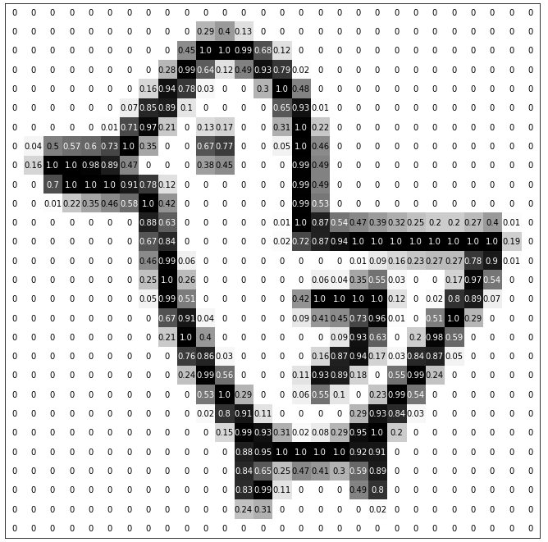

Slide 12
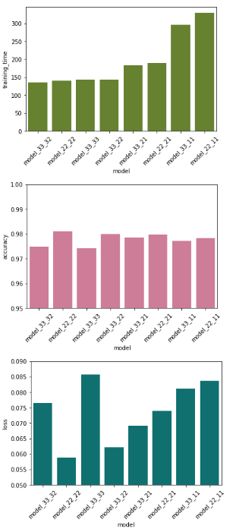
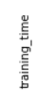
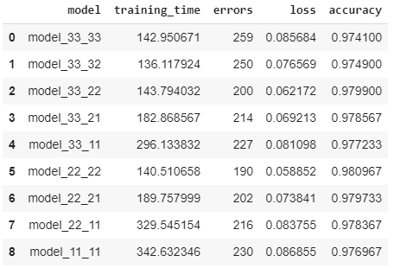
Max Pooling
Smaller window size
Smaller stride
Longer training time?
Larger window size
Smaller accuracy

Slide 13
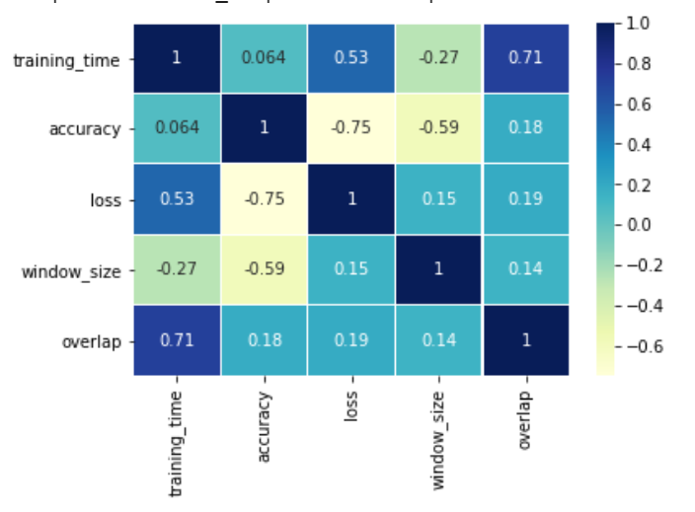
Correlation for Max Pooling models

Slide 14
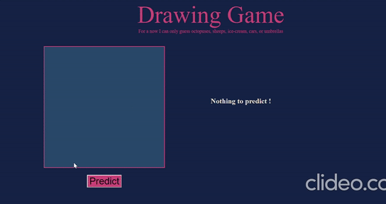

Slide 15
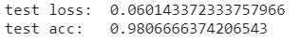
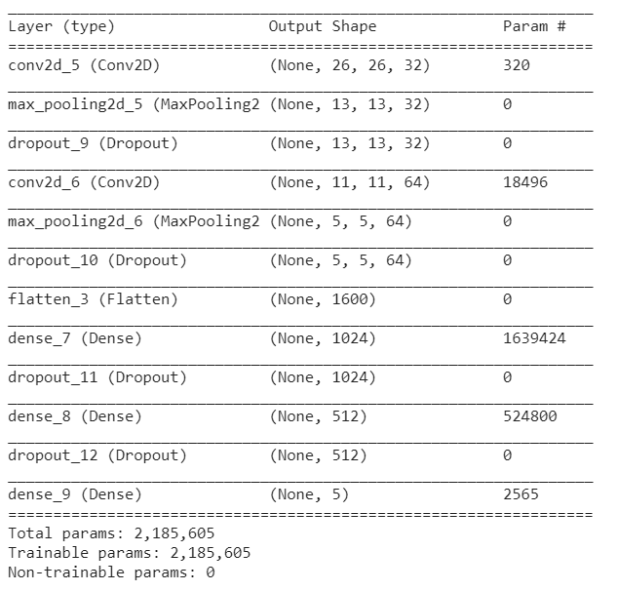
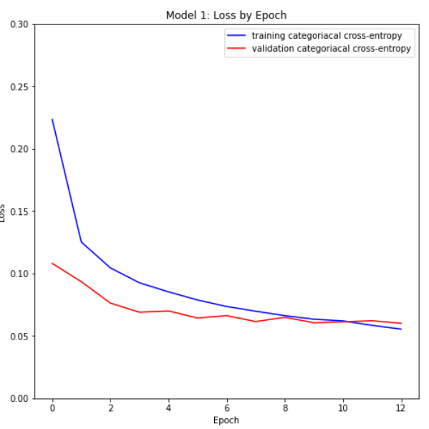
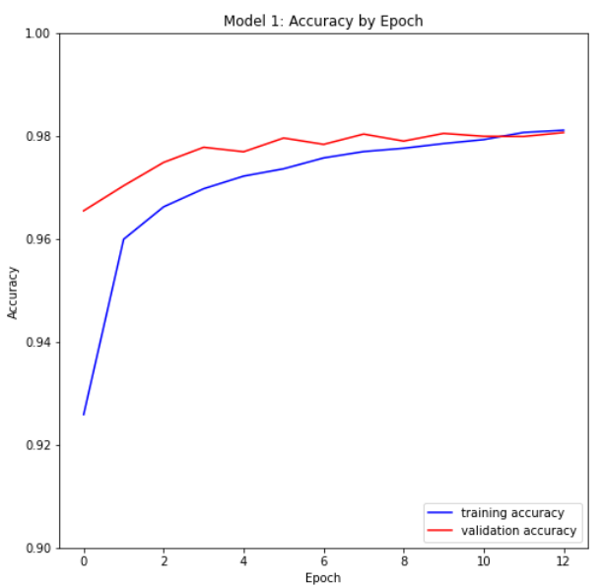
Model
Small pooling window (2x2)
No overlapping

Slide 16
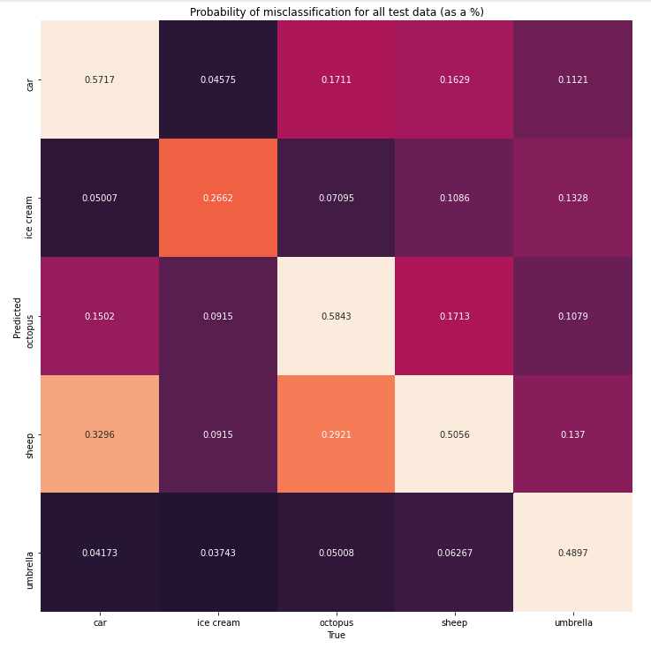
Some misclassifications:
A sheep or a car ?
A sheep or an octopus?
How to improve the model?
One way is to work with the original data (256x256 images) instead of the simplified files.

Slide 17
Thank you!

